Slide 1
Data Science Teams
Lecture – 6
Sumita Narang

Slide 2
Objectives
Data Science Teams
Defining Data Team
Roles in a Data Science Team
Data Scientists
Data Engineers
Managing Data Team
On boarding and evaluating the success of team
Working with other teams
Common difficulties

Slide 3



Data Science Project – Team structure
PROJECT SPONSOR
IT / OPERATIONS TEAM
DATA SCIENCE TEAM MANAGER
DATA ANALYST/ VISUALIZATION EXPERTS
DATA SCIENTIST(S) Team
DATA ARCHITECT/ ENGINEER(S)
SUBJECT MATTER EXPERT
Researchers
Machine Learning Engineers
CLIENT
Computer Science/ IT
Mathematics & Statistics
Domain / Business Knowledge
SW Development
Machine Learning
Traditional Research

Slide 4
Roles in Data Science Project
Project Sponsor
Represents business interest, maintains vision
Person who wants data science results
Decides if project is success or failure
Manage stakeholder expectations
Project Management, planning/tracking & Facilitator
Data Scientist
Data Architect/ Engineer
Data Analyst/ Visualization expert
Subject Matter Expert- SME
IT/ Operations Team
Understands business objective
Business process domain expert
Defines roadmap
Defines sources of input data, input data formats, important/non-important data
Helps in defining data dependencies, i/p vs o/p data relation
Builds application around the logic/algorithm devised by Data Team
Responsible for deploying the project in the IT infrastructure
Implements the overall f/wk for continuous data collection/feed, data cleaning/ preparation, data modelling and prediction
Depicts results visually
Design the project steps
Pick the data sources
Pick the tools to be used
Data Preparation
Performs statistical tests and procedures
Applies machine learning models
Evaluates results
Key collaborator among multiple entities -SME & project sponsor, IT Team and Data Team
Enables project vision and goals to be aligned
Build Data driven platform i.e. Data warehousing, Data Lakes, streaming platforms or other solutions to aggregate data
Operationalize Algorithms and Machine Learning models with data changing over time
Data Integration – from different data sources identified by Scientist
Business level story telling
Build Dashboards and other visualizations
Provide insights through visual means

Slide 5
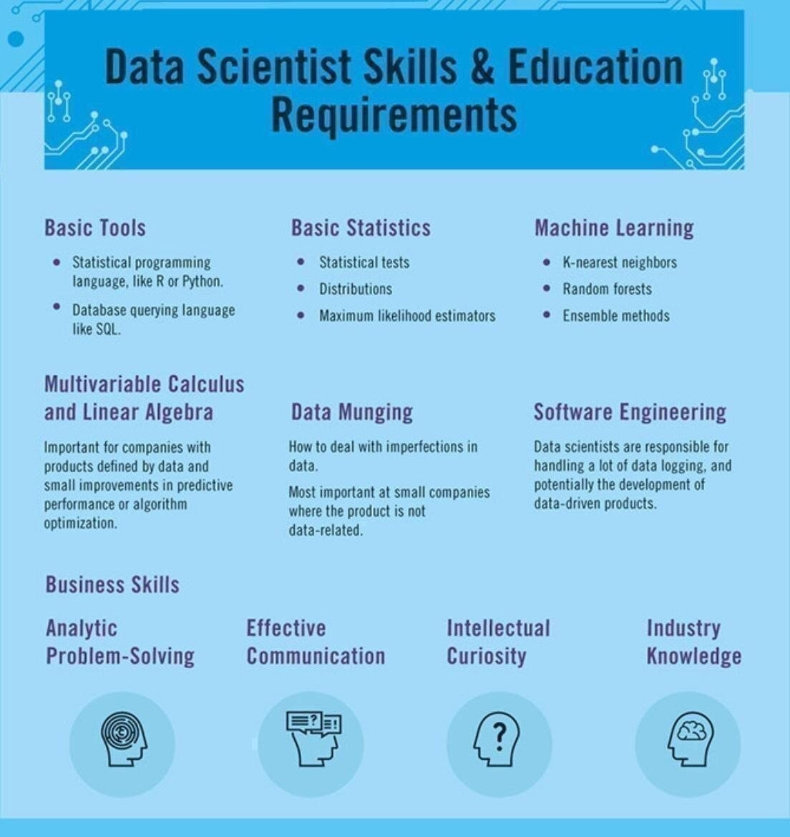
Skills Required – Data Scientist

Slide 6
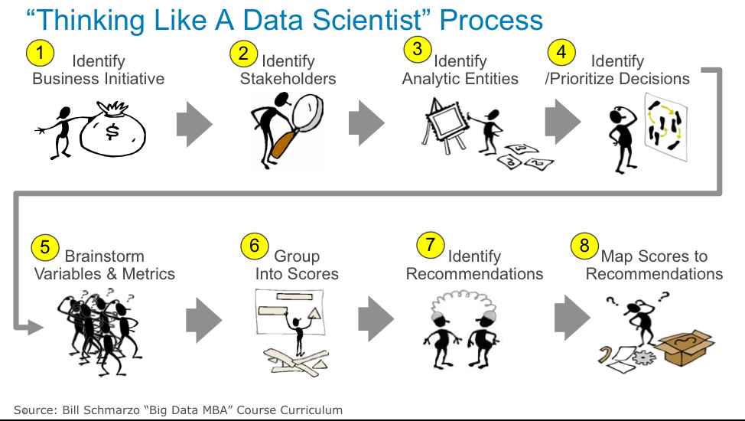
Data Scientist

Slide 7
Skills Required
Project Manager
Project management
Business acumen & vision
Team management
Stakeholder management
Tools – Jira, Azure, DevOps, Agile
Subject Matter Expert
Hands-on domain expert on business process
Tools: Domain specific
IT /Operations Team
Software development – C/C++, Java, Python etc.
SQL/NoSQL Database querying & scripting skills
Hands-on programming knowledge of Data science frameworks – Tensorflow, Kreas etc.
Cloud / in-house data center deployment skills
Operational skills to monitor deployment platform

Slide 8
Data Engineer vs Data Analyst vs Data Scientist
Data Scientist
Data Architect/ Engineer
Data Analyst/ Visualization expert
Design the project steps
Pick the data sources
Pick the tools to be used
Data Preparation
Performs statistical procedures
Applies machine learning models
Evaluates results
Key collaborator among multiple entities -SME & project sponsor, IT Team and Data Team
Enables project vision and goals to be aligned
Build Data driven platform i.e. Data warehousing, Data Lakes, streaming platforms or other solutions to aggregate data
Develop data set processes for Data modelling, mining & production; with data changing over time
Data Integration – from different data sources identified by Scientist
Business level story telling
Build Dashboards and other visualizations
Provide insights through visual means
SKILLSET
Data Management : SQL, No-SQL
Data preparation: Python, SAS, R, Scala
Data analytics: Power BI, SRSS, Tableau
Data Modelling – Machine learning algorithms. Statistical learning, Neural network (Tools - IBM Watson, SPSS, Deep Learning)
Data Management : SQL, No-SQL
Data Warehousing tools
Data Purging, archiving, scripting
Tools eg. – Oracle, Cassandra, MySQL, MongoDB, Hive, neo4j, Postgress, sqoop, Hadoop/HDFS etc.
Data analytics tools: Power BI, SRSS, Tableau

Slide 9
Data Scientist Vs. IT SW Programmer
IT SW Programmer
Software engineers work on front-end/back-end development, build web and mobile apps, develop operating systems and design software to be used by organizations.
A software engineer creates deterministic algorithms. Every program that a software engineer writes should produce the exact same result every time it runs.
Programmers typically work with SQL databases and programming languages like Java, Javascript, and Python.
Data Scientist
Data scientists, focus on building predictive models and developing machine learning capabilities to analyze the data captured by that software. Data scientists specialize in finding methods for solving business problems that require statistical analysis
Data scientists create probabilistic algorithms. Data scientists, however, because they are dealing with statistics, can’t always guarantee an outcome.
Data scientists typically also work with SQL databases as well as Hadoop data stores. They are more likely to work in Excel and frequently program with statistical software like SAS and R. There is also a big trend toward Python but with different libraries (Numpy, Pandas, etc.) than are used by programmer

Slide 10
Data Science -> AI Skillset
Data Science
Artificial Intelligence
Data Management : SQL, No-SQL
Data preparation: Python, SAS, R, Scala,
Data analytics - Power BI, SRSS, Tableau etc.
Statistical Learning, Neural networks
In-depth programming skills in python/C/C++/Java
Data Scientist needs software programming skills, but more focused around data preparation, modelling, presenting.

Slide 11
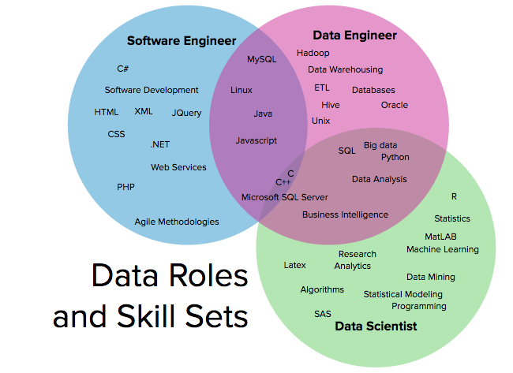
Skills Venn diagram

Slide 12
Managing Data Science Team 2/
- Attracting Top Talent
What’s your differentiated value proposition for candidate data scientists? List three things that make the opportunity unique, that you think will resonate with your target candidate pool. Test your pitch on your group. Get feedback.
- Hiring Process
What are the three most important attributes for your candidates?
What is your assessment plan for each?
- Onboarding
What activities and outcomes need to have been achieved in the first 30, 60, and 90 days?
What are the most important pieces of “tribal knowledge” your new hire needs to know, and how will she learn them? Examples include data sources, project methodologies, stakeholder dynamics, notable wins and losses, etc.

Slide 13
Managing Data Science Team 3/
Retention and Management
What skills do you hope this candidate develops over the first year?
What metrics will determine success of this candidate after a year? Examples include certain business metrics, community contributions, number of insights produced, or project iteration velocity.
How to Retain Your Talent
Don’t oversell the role. Half of data scientists stay at their jobs for two years or less. To reduce turnover, be truthful about the position you’re hiring for.
Understand team members’ motivations. Take out time to discover each employee’s goals, interests and personal incentives. Then you can pair them with rewarding projects and recognize accomplishments in a meaningful way.
Offer support. Data science can be a discipline of failures: Models fail, processes fail, data sources turn out to be terrible. Offer positive reinforcement and remind team members that it can take years to see an impact. Help team break the problems into manageable chunks so employees aren’t intimidated by an overwhelming project.
Create learning opportunities. Data scientists often leave their jobs because they’re bored. If core projects aren’t cutting-edge, creating opportunities for team members to learn new things, such as a weekly lunch to discuss the latest research or occasional hackathons to test a new software framework or computational technique.

Slide 14
Habits of Successful Data Science Managers
The following are the seven habits we have observed in many successful data science managers, in no particular order.
Build bridges to other stakeholders. Avoid friction and crossed wires by opening communication channels with other teams. Consider putting a data scientist and product manager in a room for an hour before each new project to ensure they’re on the same page. Making data scientists attend meetings without their laptops can force them to communicate with other stakeholders. Giving data scientists opportunities to explain their work to engineers, product managers, and others can also improve communication.
Track performance. Use a template to keep track of what you discussed, the objectives you set, and the feedback you gave during one-on-one meetings with your reports. Relying on memory won’t work.
Aim to take projects to production. Preparing teams to deploy their own API services and to productionalize code helps you move faster, and you don’t get blocked on engineering resources that might not be available.
Start on-call rotation. As teams get bigger, set up a weekly rotation of data scientists on call to fix models that break. That encourages better documentation and gives those not on-call time to focus on core projects.
Ask the dumb questions. Seemingly simple questions can open the door to identifying and solving fundamental problems.
Always be learning. Read prolifically to keep up with developments in this quickly evolving field. Consume not only technical material, but also insights about management and organizational psychology.
Get out of the way, but not forever. If you’re a new manager, consider stepping away from coding for three to six months. Otherwise, you risk never truly embracing the manager role, and might under-serve the team. After that, feel free to tackle non-critical projects or those nobody else wants to do.

Slide 15
Common Challenges 1/
Hiring a balanced data science team - build a cross-functional data science team that enables your organization to get insights from data and build production ready models.( Data Scientist, machine learning Engineer, Data Architect/Engineer, SW Developer, Research Scientist)
Retaining the team and Growing the team
Translating the business goals to smaller chunks of tasks, and defining measurable KPIs for the Data Science Team to work on achieving these KPIs.
Transforming Data Science team output/deliverables to a business understandable form, with key focus on Data Visualization. Hence try to bridge the gap between the Business Teams who relatively less/non-technical and the very technical Data Science Team
Engage and keep team motivated during the failures, and also keep the Senior leadership aligned with the fact that Data Science Projects are not like any SW Engineering project which can very Agile and give results every 7 days.

Slide 16
Common Challenges 2/
Prioritize work: team is flooded with requests for some analytics report or some other data crunching requests. These adhoc requests consume lot of time and it impacts the long term projects and other key deliverable. It’s important prioritize work and assign right priority to these adhoc tasks. It is better to an adhoc requests backlog and added priority to these tasks. The team could then manage these urgent requests better without sacrificing the time towards important tasks.
Data quality: Are you getting the right data? You may have plenty of data available, but the quality of that data isn’t a given. To create, validate, and maintain production for high-performing machine learning models, you have to train and validate them using trusted, reliable data. You need to check both the Accuracy and Quality of the data. Accuracy in data labeling measures how close the labeling is to ground truth. Quality in data labeling is about accuracy across the overall dataset. Make sure that the work of all of your annotators look same and labeling is consistently accurate across your datasets.

Slide 17
Common Challenges 3/
Tools : Tools play an important role because they allow you to automate. You should use relevant tools to do heavy lifting jobs, running scripts to automate queries and processing data to save some time which can in turn be used to make the team more productive. Choosing the right set of tools as per your needs.
Processes -Data science team projects are research oriented or start with lot of research activities , it’s difficult to predict how long it will take for them to finish. Also lot of activities like model building, data crunching are usually done by a single person, so traditional collaborative workflows don’t fit. You have to identify an approach which works best for your team. For example, we run a mix of Kanban and Scrum boards in JIRA. For Research Activities, Data Exploration/Analysis, Exploring ML models go for Kanban mode while as Productization of the models you can work as a Scrum team. So basically your Data scientists, Research Scientists and ML Engineers work mostly in Kanban mode where as Data Engineers, Software Engineers work in Scrum mode. Evaluate various options and see what best works for your team and projects.
Knowledge Management for data science team – Data and Models

Slide 18
Knowledge Management for Data Science Teams 1/
What is knowledge management?
The goal of knowledge management is to capture insight, which can be defined as “better understanding.” Insight is thus relative—it’s about constantly improving upon previous ideas.
Creating that kind of “compounding machine” requires a way to capture knowledge, a framework for users to follow and mechanisms to improve through feedback.
Why is knowledge management difficult?
Organizing knowledge in advance is difficult. Classifications are often too rigid, since you don’t know what will matter in the future.
There are few incentives to participate. As one data scientist said, “I get paid for what I build this year, not maintaining what I built last year.”
It’s a classic collective action problem. No one wants to be the first to spend time on documentation. When knowledge is being captured, it can be hard to know how to act on it.
Systems always lag behind reality. If knowledge management takes extra time and is done in a different system from the core work, its quality will suffer.

Slide 19
Knowledge Management for Data Science Teams 2/
Other obstacles are unique to data science teams:
People use different tools. Knowledge management is tougher when some team members work in R and others in Python, and when some store code on GitHub and others in email. Training people to use the same systems is difficult because of high turnover.
The components of a single project are scattered. Artifacts and insights may be spread across a Docker store, a wiki, a PowerPoint presentation, etc.
If you have code, that doesn’t mean you can rerun it. A meta-analysis of 600 computational research papers found that only 20 percent of the code could be re-run; of that share, many second attempts yielded slightly different results.
How to improve knowledge management
There are four steps that can help data science leaders improve knowledge management in their enterprise organizations:
Capture as much knowledge as possible in one place.
The more things are in there, the more connections you have across them, and the value grows that way. You don’t want people operating on the fringes. A common platform that encompasses both the core work and knowledge management is key to ensure it gets done and minimizes the burden. If you can’t capture everything, start with the most valuable model or knowledge, and build a system around that.
Choose a knowledge management system that allows for discovery, provenance, reuse, and modularity
Discovery: Data scientists spend much of their time searching for information, cutting into productivity. Teams have to decide whether to curate knowledge (the Yahoo approach) or index it (the Google approach). Curation makes sense when the domain is relatively stable. Indexing and searching is best when the domain is fluid, and you can’t possibly know beforehand what the taxonomy should look like.

Slide 20
Knowledge Management for Data Science Teams 3/
Provenance: Let people focus on the aspects of knowledge management that matter. Use a platform that allows people to synthesize their work, not have to track which software version they used.
Reuse: If it won’t run, it won’t get reused. That requires access to not only code, but also historical versions of datasets.
Decompose and Modularize: Ensure that people have the incentives and tools to create building blocks that can be reused and built upon.
3. Identify the right unit of knowledge
Compounding systems rely on units of knowledge. In academia, those are books and papers; in software, it’s code. In data science, the model is the right thing to organize around, because it’s the thing data scientists make. The model includes the data, code, parameters and results.
Data Annotation and Quality Assurance(QA)- Data is Key to success of any data science team. Having a well trained Data labeling team can provide significant value particularly during the iterative machine learning model testing and validation stages. Machine learning is an iterative process. You need to validate the model predictions and also need to prepare new datasets and enrich existing datasets to improve your algorithm’s results. You can either hire or outsource data annotation but challenge remains to have a consistency in labeling data and validating results.
4. Think beyond technology
Changes at the people and process levels are also important. Reframe how people see their jobs: They should spend less time doing and more time codifying and learning. Make collaboration a priority in hiring and compensation. Finally, while knowledge management should be seen as everyone’s job, some organizations create new roles for curating or facilitating knowledge.

Slide 21
Managing the Team
Focus –
- On boarding and evaluating the success of team
- Working with other teams
References –
https://hbr.org/2018/10/managing-a-data-science-team
https://www.dominodatalab.com/resources/field-guide/managing-data-science-teams/
https://towardsdatascience.com/building-and-managing-data-science-teams-77ba4f43bc58
https://towardsdatascience.com/so-youre-going-to-manage-a-data-science-team-31f075809ffd

Slide 22
Data driven decision making
Definition – When it is data and not instincts that drives the business decisions.
Examples – Fraud detection in Loans, Credit Cards (Cibil scores); Insurance, Six sigma projects to improve efficiency; Target advertising in e-commerce; Product Roadmap planning, Team planning
6 Steps to Data Driven decision making-
Strategy – Define clear Business goals
Identifying key data focus areas – Data is everywhere, flowing from multiple sources. Based on domain knowledge define key focus data sources which seem to impact the most, easier to access, reliable and clean
Data Collection & Storage – Defining data architecture to collect, store, archive i.e. manage data. Connect multiple data sources, clean, prepare and organize
Data Analytics – Analyzing the data and derive key insights
Turning insights to Actions – business actions to be taken based on the findings from key insights from data
Operationalize and Deploy – Using IT systems, automate the data collection, storage, analysis and presenting the key highlights

Slide 23
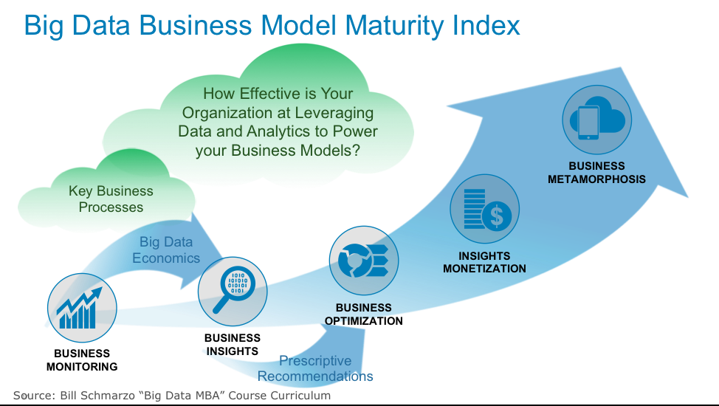
Data Business Model

Slide 24
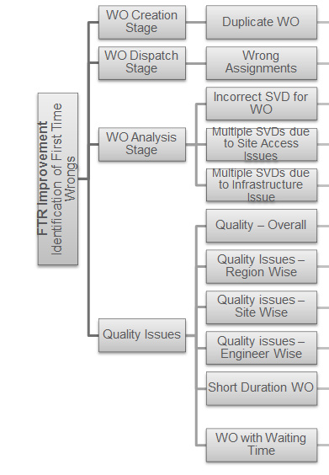
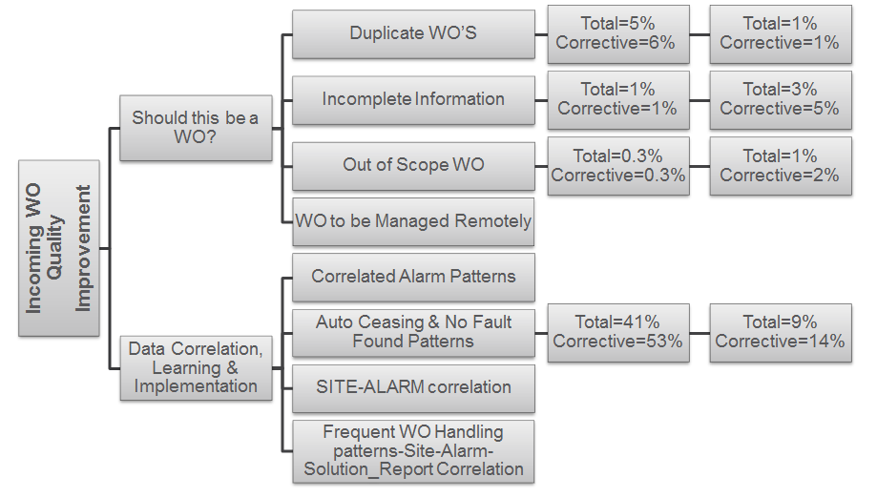
Industry Example – FSO Analytics Tool
Business Objective fro FSO Department: Target for 5 top clients in India, Europe, South Africa and Costa Rica Markets
FTR (Frist Time Right) Improvement by 2%
Improve incoming WO Quality by 5%

Slide 25
Data Science Project – Team structure
PROJECT SPONSOR – FSO HEAD
IT / OPERATIONS TEAM
(4 members)
DATA SCIENCE TEAM MANAGER
DATA ANALYST/ VISUALIZATION EXPERTS- 1
DATA SCIENTIST(S) Team (3)
DATA ARCHITECT/ ENGINEER(S) - 2
SUBJECT MATTER EXPERT – TELECOM EXPERT
Researchers (1)
Machine Learning Engineers (2)
SW Architect -1
DotNet Developers (2)
WebApp Developers -1

